Slide 1
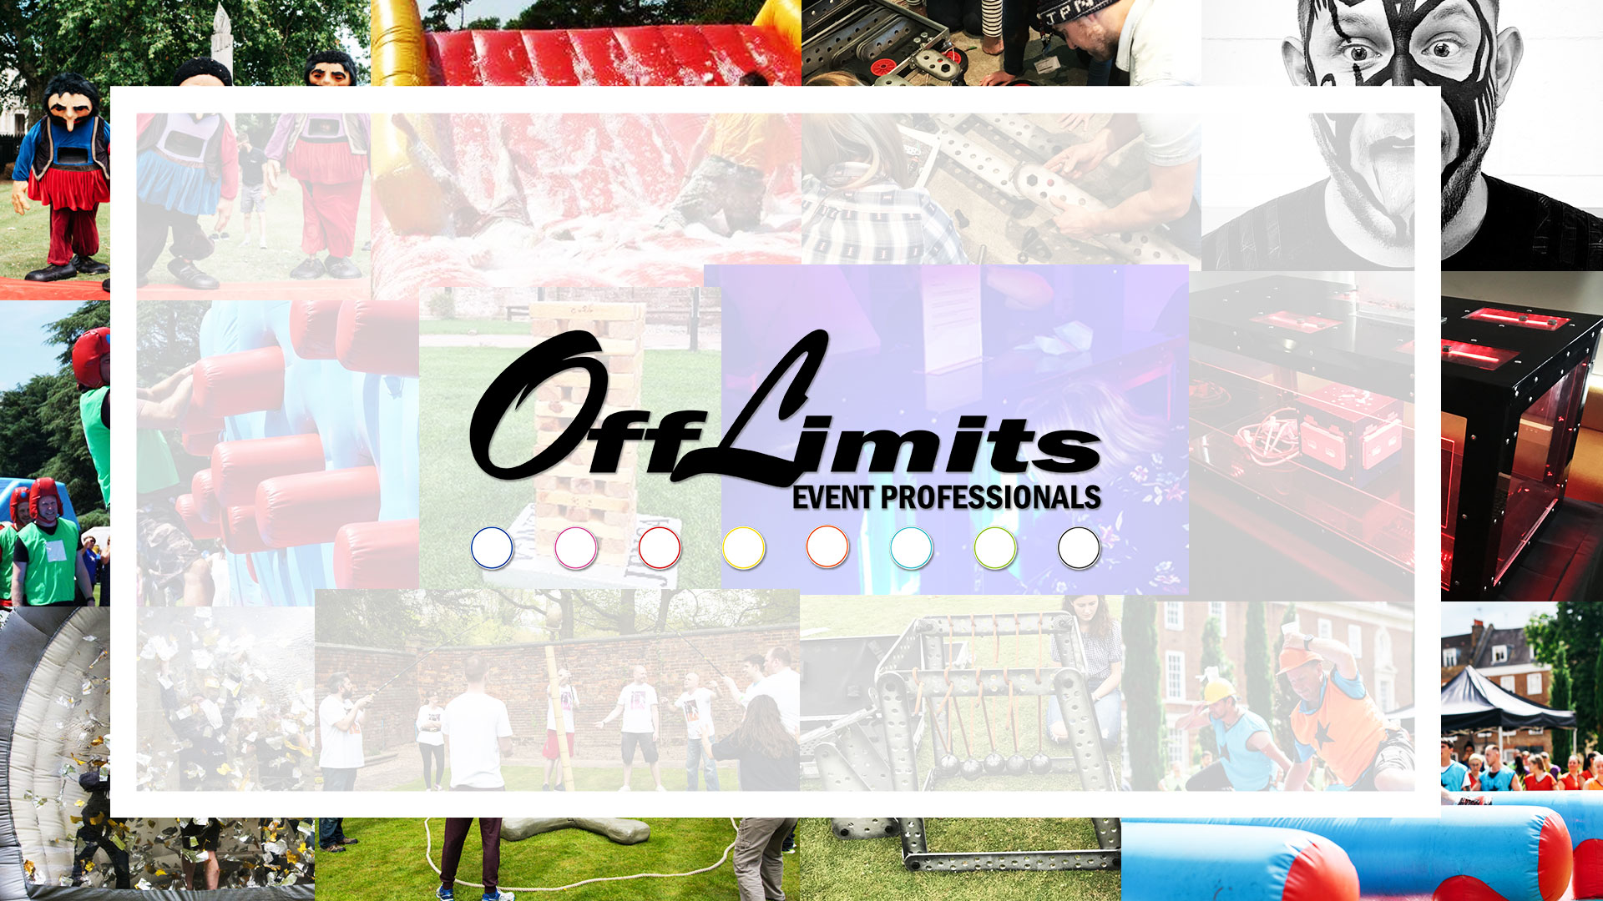

Slide 2
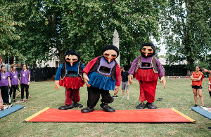
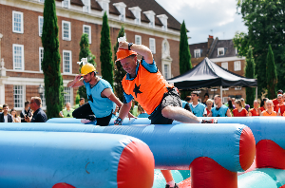
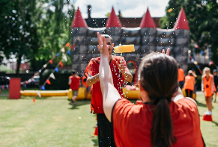
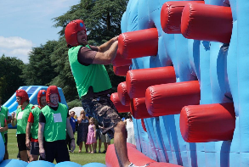
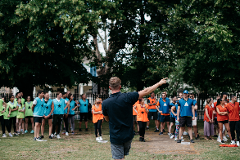
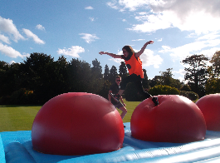

OUTDOOR TEAM BUILDING OPTIONS
I T ' S A K N O C K O U T
T O T A L L Y W I P E D O U T
D E S C R I P T I O N:
Get up off your sofa, stop wishing you could take part in It’s a Knockout and actually do it!
We own all the original inflatables, costumes and games from the hit BBC series that ruled the telly during the 70’s and 80’s! Think foam, inflatables and giant costumes – you’ll wish it’ll never end!
This comical activity will see teams competing in a series of challenges. Let loose and embrace the fun.
T E A M B U I L D I N G B E N E F I T S:
Interaction & collaboration skills
Leadership & delegation skills
Boosts morale & confidence
Friendly competition
Builds trust
D U R A T I O N:
For this activity we would suggest a running time of 1.5 - 2 hours depending on numbers.
D E S C R I P T I O N:
Challenge your team with a day they'll remember for years! Totally Wiped Out is the most unique, fun and effective corporate team building event in the world.
We've taken the best bits of smash TV game shows; Gladiators and Total Wipeout then combined them in our original game designs. Bounce for the finish line in the Big Red Balls alley, leap for victory as the Sweeper Arm comes to claim its victims, and slither through the foam-filled tunnel where the Tricky Trunks lurk!
T E A M B U I L D I N G B E N E F I T S:
Competition
Communication
Time management
Bonds team members
Boost confidence and motivation levels
D U R A T I O N:
For this activity we would suggest a running time of 2 – 2.5 hours depending on numbers.
IN PARTNERSHIP WITH
www.actiondays.co.uk
01773 766 050
sales@actiondays.co.uk

Slide 3
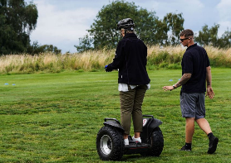
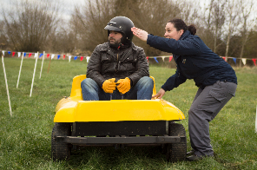
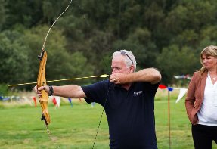
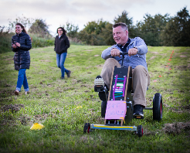
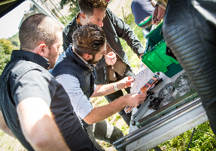
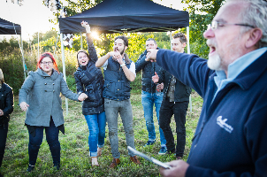
OUTDOOR TEAM BUILDING OPTIONS
M U L T I A C T I V I T Y
S O A P B O X D E R B Y
D E S C R I P T I O N:
Swap computers, smartphones and desks for country sports! Bespoke multi-activity days are all about facing fresh, fun challenges in the great outdoors. This quote is based on the below activities:
*****[SELECT ACTIVITIES BASED ON VENUE] *****
ARCHERY – LASER CLAY SHOOTING – PISTOLS – SEGWAYS – FALCONRY – SHEEPDOG HANDLING
AXE THROWING – MICRO TANKS – WACKY RACERS – RAGE BUGGIES – CROSSBOW – QUADS
T E A M B U I L D I N G B E N E F I T S:
Encourages competition
Boosts confidence and motivation
Bonds teams through shared experience
Manages resistance to change
Illustrates the importance of time management
D U R A T I O N:
For this activity we would suggest a running time of 2.5 - 3 hours.
D E S C R I P T I O N:
Robot Wars meets Wacky Races in Soapbox Derby! Using only basic materials and tools, teams build their own roadsters from scratch and go bumper to bonnet in a series of races.
Soapbox Derby is a fun, competitive team building event designed to get teams working together to achieve a common goal. Multiple team member talents are required, including design flair, innovation, creativity, and 'driving' skills... although we use the term loosely!
T E A M B U I L D I N G B E N E F I T S:
Improves communication
Develops problem solving abilities
Teaches the art of resourcefulness
Hones leadership and delegation skills
Encourages creative thinking
Illustrates the importance of individual team member roles
D U R A T I O N:
For this activity we would suggest a running time of 3 – 3.5 hours.
IN PARTNERSHIP WITH
www.actiondays.co.uk
01773 766 050
sales@actiondays.co.uk

Slide 4
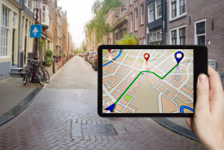
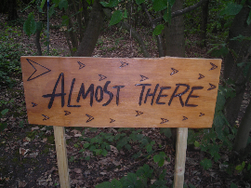

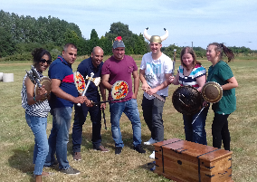
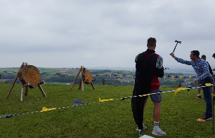
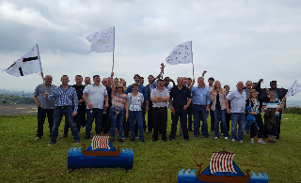
OUTDOOR TEAM BUILDING OPTIONS
T A B L E T T R E A S U R E H U N T
C L A I M O F T H R O N E S
D E S C R I P T I O N:
We’ve reloaded the treasure hunt with tablets, an ingenious app, team selfies, video challenges and real time features! Answer questions and unlock challenges to earn points.
Keep an eye on the opposition using the live leader board. There’s no official route, so put your heads together and plan one that’ll get you from A to B in double quick time. Rack up the most points and race to the finish line before the sands of time run out.
T E A M B U I L D I N G B E N E F I T S:
Communication Collaboration
Lateral thinking
Leadership and delegation
Time management
Creativity
D U R A T I O N:
For this activity we would suggest a running time of 2.5 hours.
D E S C R I P T I O N:
Immerse yourself in an event fit for true leaders and true alliances, as you and your fellow house members compete with opposing teams for the honor of the Throne of Steel and to be crowned victors in the final race to Eastaros.
You have one task, to make it through all four challenges, earning points as you go! Who will wipe out the other promising kings and queens in the final battle for glory.
T E A M B U I L D I N G B E N E F I T S:
Problem solving
Lateral thinking
Time management
Leadership and delegation
Encouraging competition
Communication, interaction and collaboration
D U R A T I O N:
For this activity we would suggest a running time of 2.5 hours, depending on numbers.
IN PARTNERSHIP WITH
www.actiondays.co.uk
01773 766 050
sales@actiondays.co.uk

Slide 5
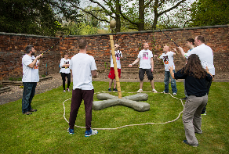
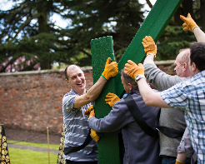
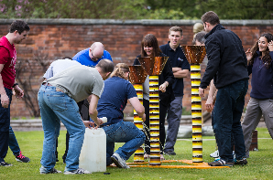
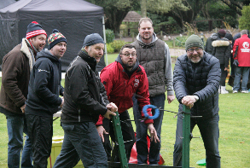
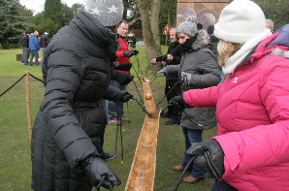
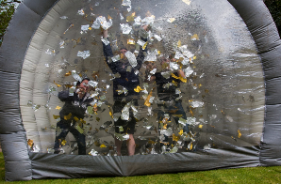
OUTDOOR TEAM BUILDING OPTIONS
T E A M W O R K C H A L L E N G E
O U T D O O R C R Y S T A L Q U E S T
D E S C R I P T I O N:
Team building is essential in developing businesses, highlighting individual strengths, opening up lines of communication and learning new skills. Off Limits have designed a team build to tackle this. Our Teamwork Challenge does exactly what it says on the tin!
Off Limits will provide a series of head-scratching and brain busting challenges, designed to make you collaborate as a team.
T E A M B U I L D I N G B E N E F I T S:
Communication
Time management
Team unification
Leadership
Recognizing strengths and weaknesses
D U R A T I O N:
For this activity we would suggest a running time of 2.5 hours.
D E S C R I P T I O N:
Crack cryptic clues, take on mental and physical challenges, and travel through fantasy themed zones in our own take on the TV classic Crystal Maze. No Crystal Maze is complete without a Crystal Dome finale! You will need to scramble around for the cash but have you got your wits about you to succeed? Can you come out the dome a winner?
Think crystals, zones, domes and golden tickets! You have one mission, to make it through all four zones of the maze earning as many crystals as you can on your way.
T E A M B U I L D I N G B E N E F I T S:
Communication, interaction & collaboration
Problem solving & lateral thinking
Time management
Leadership and delegation
Encouraging competition
D U R A T I O N:
For this activity we would suggest a running time of 2.5 - 3 hours.
www.actiondays.co.uk
01773 766 050
sales@actiondays.co.uk

Slide 6
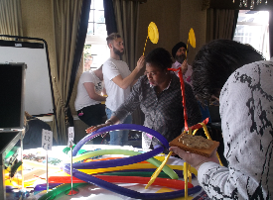

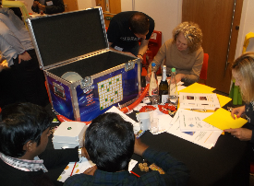
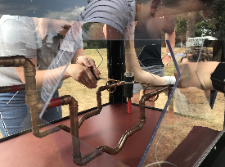
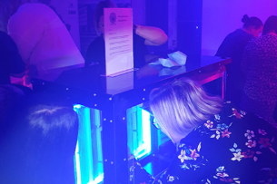
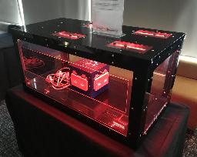
INDOOR TEAM BUILDING OPTIONS
L O C K B O X C H A L L E N G E
I N D O O R C R Y S T A L Q U E S T
D E S C R I P T I O N:
The clock is ticking, you have seconds remaining - can you crack the code to get inside the flight case? Sounds like a simple task? It’s only a padlock and an unusual key in the way! Frustration kicks in. Nothing is as simple as it seems. Debates ensue, leaders change; can you crack the case?
This an energetic, fast paced, engaging event which is sure to get all team members involved and working to a common goal, but of course with the added dose of fun!
T E A M B U I L D I N G B E N E F I T S:
Problem solving
Mathematical
Creative
Logical
Lateral thinking
D U R A T I O N:
For this activity we would suggest a running time of 1.5 hours.
D E S C R I P T I O N:
Have your teams got what it takes to beat the maze or will it have the last laugh? In true explorer style your teams will need to complete a series of mini challenges to move on from one themed challenge to the next.
This is the ideal team building solution designed to inject fun, break barriers and boost morale!
T E A M B U I L D I N G B E N E F I T S:
Goal setting
Problem solving
Confidence booster
Encourages competition
Creative thinking
D U R A T I O N:
For this activity we would suggest a running time of 1.5 - 2 hours.
www.actiondays.co.uk
01773 766 050
sales@actiondays.co.uk

Slide 7
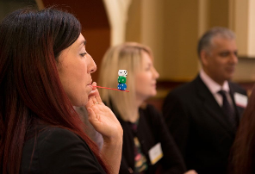
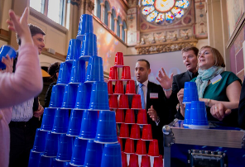
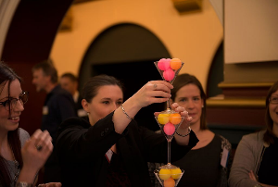
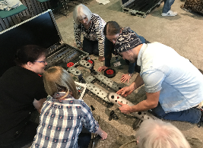
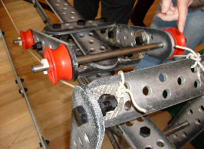
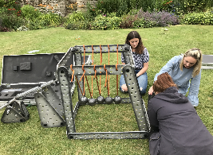
INDOOR TEAM BUILDING OPTIONS
I N I T 2 W I N IT
M O T I O N M A C H I N E
D E S C R I P T I O N:
30 seconds remaining… Do you have a steady hand? 10 seconds remaining… Do you have the state of mind?
The countdown starts. Your team is cheering you on. You have two minutes to succeed and not everything is as easy as it looks. Choose wisely and utilise the strengths of each individual team member. Will you fall to pieces or are you In it 2 Win it?!
T E A M B U I L D I N G B E N E F I T S:
Goal setting
Problem solving
Confidence booster
Encourages competition
Creative thinking
D U R A T I O N:
For this activity we would suggest a running time of 45 minutes - 1 hour.
D E S C R I P T I O N:
Retro appeal and race against time tension – Motion Machine is an ingenious event that combines Giant Meccano and Mouse trap. Two classic games and a chance to relive the glory days! Teams must ultimately come together to culminate in a grand finale!
Brilliant for working towards one goal, the Motion Machine brings everyone together to work as one.
T E A M B U I L D I N G B E N E F I T S:
Communication & collaboration
Problem solving
Lateral thinking
Leadership & delegation
Resourcefulness
D U R A T I O N:
For this activity we would suggest a running time of 1 - 2 hours, depending on numbers.
:
www.actiondays.co.uk
01773 766 050
sales@actiondays.co.uk

Slide 8
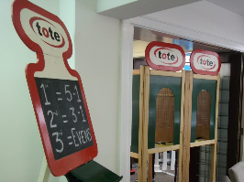
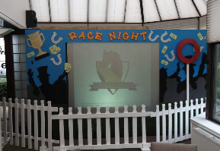
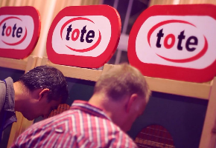
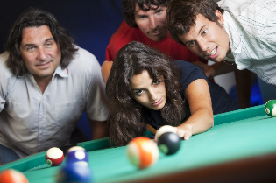
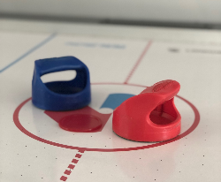
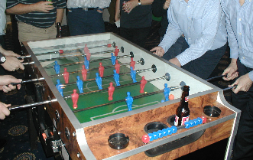
EVENING TEAM BUILDING OPTIONS
R A C E N I G H T
T E A M G A M E S
D E S C R I P T I O N:
Who needs Royal Ascot when you have an Off Limits Race Night?! Tipped as the bookies favourite to be a success, you and your guests will not be disappointed!
Get your hearts racing and fritter away fun money and as we give the Grand National a run for its money!
T E A M B U I L D I N G B E N E F I T S:
Enhances communication skills
Budget management
Informal environment
Team bonding
Delegation
D U R A T I O N:
For this activity we would suggest a running time of 2 hours, depending on numbers.
D E S C R I P T I O N:
Combining the best games from your adult years and the most memorable from your child hood, we will provide a night that is sure to please. Guests will compete head to head around a series of popular games that will test not only your nerve, but yours reflexes and aim too.
This is an evening full of variety that is guaranteed to get different teams interacting throughout the duration, build on bonds, and encourage healthy competition in an informal and relaxed environment.
T E A M B U I L D I N G B E N E F I T S:
Interaction & collaboration skills
Boosts morale & confidence
Friendly competition
Breaks the ice
D U R A T I O N:
For this activity we would suggest a running time of 2 hours, depending on numbers.
www.actiondays.co.uk
01773 766 050
sales@actiondays.co.uk

Slide 9
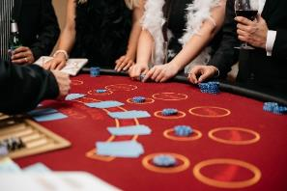
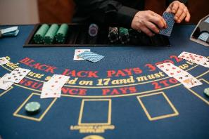
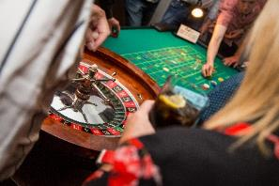
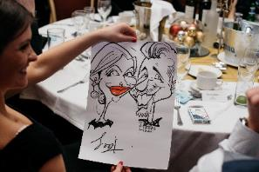
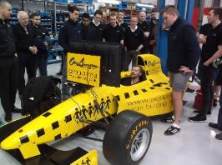
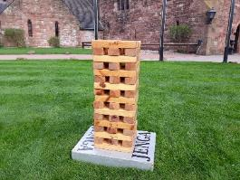
INFORMAL EVENING OPTIONS
C A S I N O
I N F O R M A L O P T I O N S
D E S C R I P T I O N:
Casino evenings have universal appeal. They're great for breaking the ice and will get all guests participating in the fun. Guests can get acquainted over a friendly game of poker.
We have all the classic Vegas games and tables:
Roulette - there are plenty of ways to play this nail-biting game of chance. Play it safe by betting on odds or evens. If you're feeling lucky, risk it on a spin of the wheel and take a punt on which number the ball will land on.
Blackjack - probably the most popular casino card game of all time. Achieve the magic total of 21 and beat the dealer at his own game.
Craps - the ultimate crowd-pleaser. Craps has been featured in countless Bond movies. Fast, fun and intense, Craps always attracts a big crowd. Spectators and players get totally immersed in the fun. Everything rides on a roll of the dice.
Poker - the old time favourite. Have you got your poker face at the ready? It's all about strategy in this game of cards, will you have the winning hand?
D U R A T I O N:
For this activity we would suggest a running time of 2 hours.
Why not put together your own informal package!
Let us know what you would like from the list below and we will put together the best package for you:
CASINO TABLES
SLOT MACHINES
SELFIE MIRROR
F1 SIMULATOR
MAGICIAN
CARICATURIST
MIND READER
SINGING WAITERS
COCKTAIL MAKING
FAIRGROUND STALLS
AIR HOCKEY
TABLE FOOTBALL
GIANT GAMES
TABLE TENNIS
POOL TABLE
GIANT SCALEXTRIC TABLE
HIGH STRIKER
DJ & KARAOKE
www.actiondays.co.uk
01773 766 050
sales@actiondays.co.uk

Slide 10

OFF LIMITS
WHO WE ARE
A truly great team building day or corporate event should make every single employee feel like a superhero!
With over 20 years' experience under our belts we have the knowhow, creativity, contacts and expertise to make your corporate event a triumph.
Don't just take our word for it, see our reviews: https://www.actiondays.co.uk/reviews/
Want further event options? Take a look at our website https://www.actiondays.co.uk/

